Slide 1
Hamster Capstone 66% Status Update
By: Jared Hemauer, Rylee Horney, Keenan Keams, Joseph Lopez

Slide 2
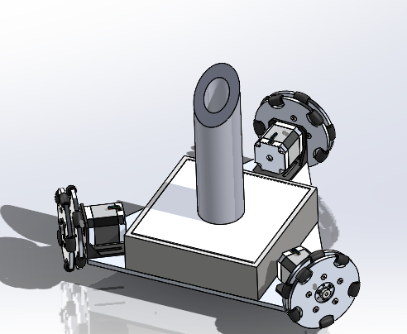
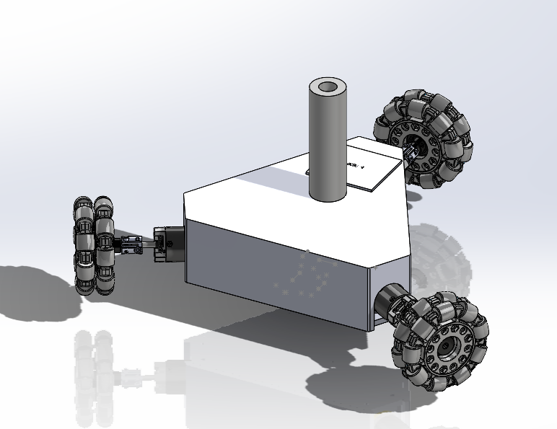
2nd & 3rd Iteration of Hamster

Slide 3
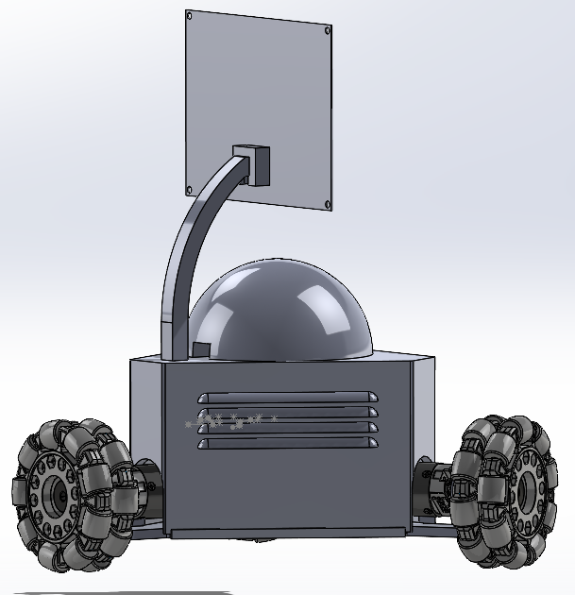
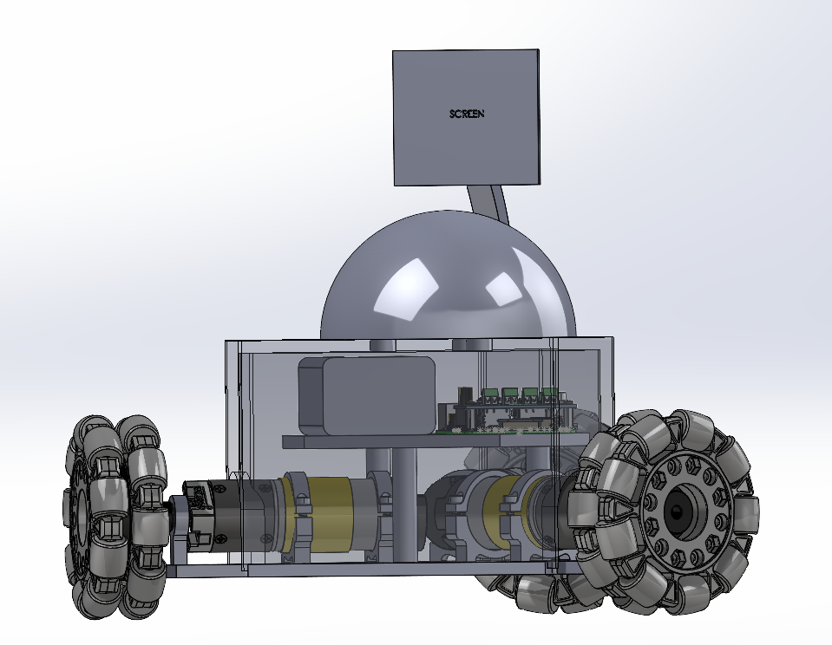
4th & 5th Iteration of Hamster

Slide 4
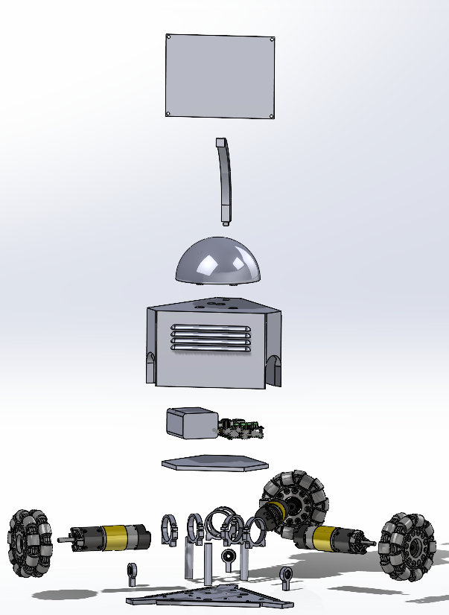
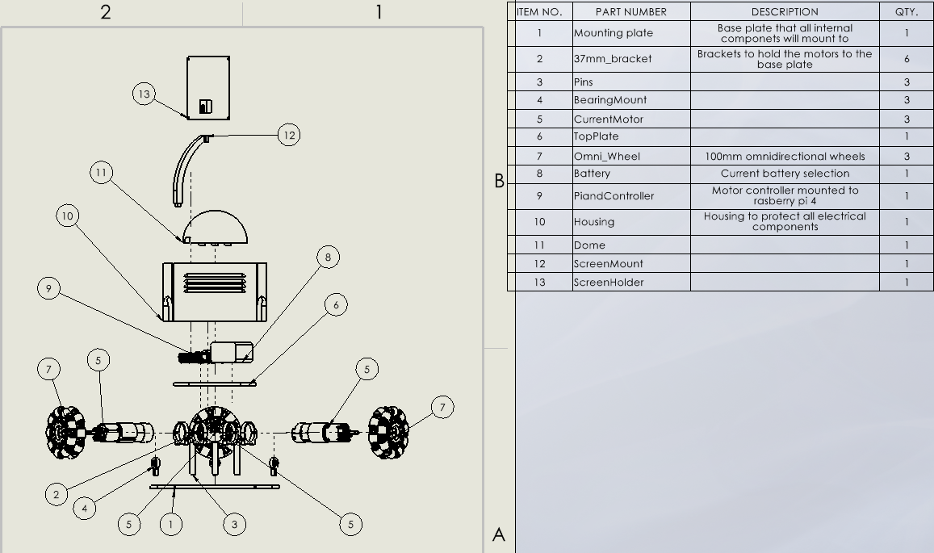
Exploded View

Slide 5
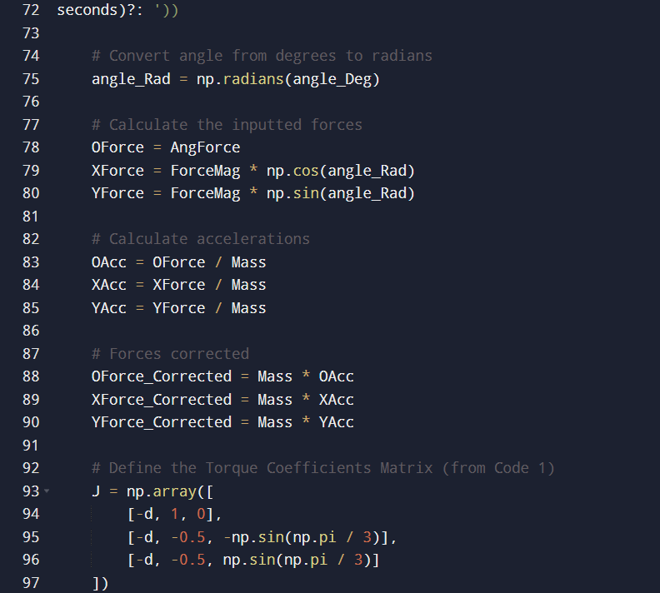
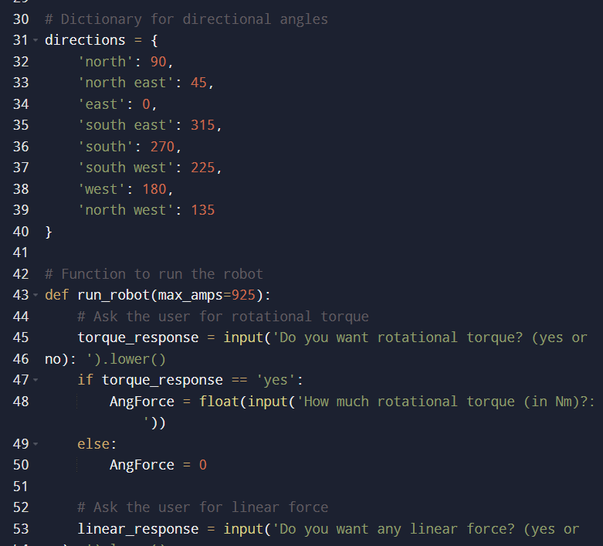
Coding for Robot

Slide 6
Thank you

